Slide 1
Marksheet Parsing
Extracting entities (Student name, School name and marks) from an input marksheet image

Slide 2
OBJECTIVE
Given is an image of academic marksheet of a students.
The following are the entities to be extracted from the marksheet:
Student Name
School Name
Marks

Slide 3
APPROACH
Instead of performing OCR on the whole image, area of interest is been defined first and OCR is then been performed on the areas of interest like name, marks and school name only.
Prepare a dataset of marksheets by labeling the areas of interests (name, school and marks) with bounding boxes.
Train a YOLO v8 model on these labeled images to make the model identify area of interest on its own in a marksheet.
Segment the identified images and store them in separate folders with separate class name.
Perform OCR via easyocr on the segmented images hence eliminating the need for entity extraction.

Slide 4
Why YOLOv8?
YOLO (You Only Look Once) is one of the most efficient real-time object detection models.
Since our dataset has a specific format and template, it makes it suitable for YOLO to identify the areas of interests.
Our task involves drawing bounding boxes around areas of interests in each marksheet → YOLOv8 natively supports bounding box regression.
Small Dataset Friendly (Transfer Learning): We can fine-tune a pre-trained model on a small custom dataset and still get reliable performance.

Slide 5
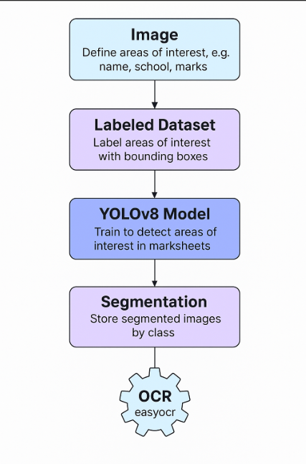

Slide 6
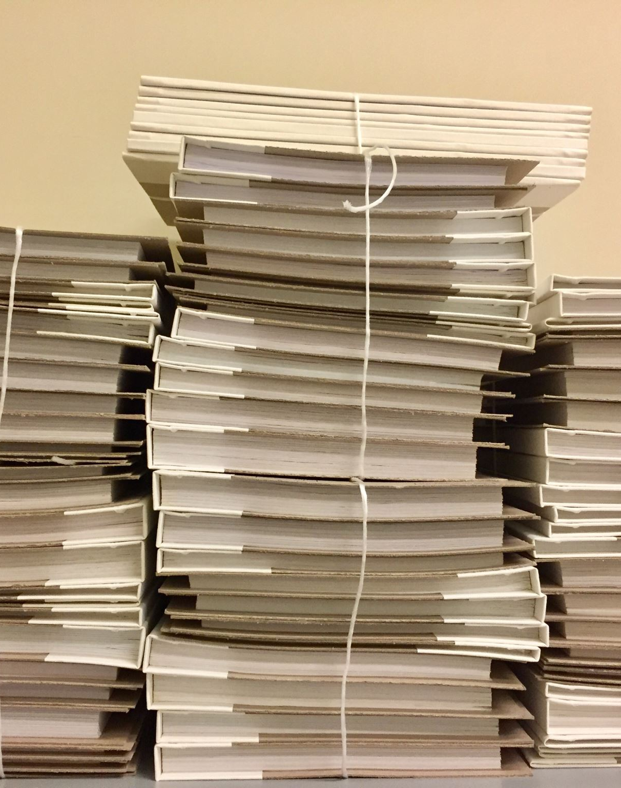
DATA PREPARATION
Collect the images of marksheets.
Make bounding boxes to label the areas of interests.
Used Label Studio to label the data for separate areas of interests in the images.
Exported in YOLO format with images having images in one folder, their labels in another folder in .txt format.
Splitted this data into test and train (80%-20%) each having images with their corresponding labels.

Slide 7
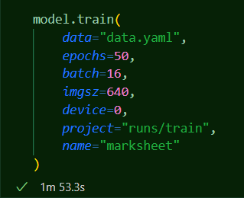
TRAINING
Model is trained with:
EPOCHS: 50
BATCH SIZE: 16
IMAGE SIZE: 640
DEVICE: GPU

Slide 8
YOLO evaluation and further steps
The model can identify the areas of interests accurately with the following evaluated metrices:
- Precision: 0.91731879
- Recall: 0.98453921
YOLO can precisely identify the areas of interests in a marksheet image now
Next, we have to segment this area and store in separate classes
Then OCR will be performed on the segmented images

